Slide 1


Phishing website URL Detection
Ensemble Machine Learning & Real-Time Heuristic Analysis
Group 10 - Section B
G Harshith Sai | AP23110010170
Nissi Praharsha C | AP23110010221
M. Varshita | AP23110010206
D. Siva Kaushik | AP23110010841

Slide 2
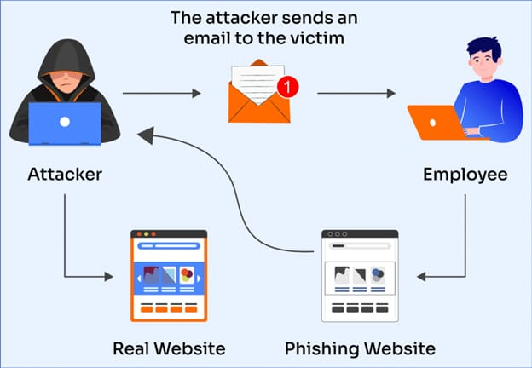
The Latency Problem
Traditional security relies on blacklists. This is reactive, not proactive.
•
Zero-Day Attacks: Phishing sites live for only hours. Blacklists are too slow.
•
The Trust Gap: Users rely on visual cues which are easily spoofed (Homograph attacks).
•
Solution: We need a system that predicts malicious intent based on the structure of the URL, not just a database lookup.

Slide 3






System Architecture
Frontend
Backend
ML Engine
HTML/JS Interface using Fetch API for asynchronous non-blocking requests. 'Apple Design' aesthetic.
Python http.server (Threaded). Handles routing, feature extraction, and ML inference.
Scikit-Learn Random Forest Classifier. Trained on UCI Phishing Dataset.

Slide 4

UCI Training Data
The Foundation
# Sample Data Structure
We trained our models on the renowned UCI Phishing Websites Dataset.
id, having_IP, URL_Length, SSL_State, Result
>
Records: 11,055 distinct websites.
1, -1, 1, -1, -1
>
Features: 30 attributes per record.
2, 1, 1, -1, -1
>
Encoding: Trinary values (-1: Phishing, 0: Suspicious, 1: Safe).
3, 1, 0, -1, -1
...
>
Balance: Relatively balanced dataset, preventing major class bias.
# Features cover address bar properties, HTML tags, and domain age.

Slide 5
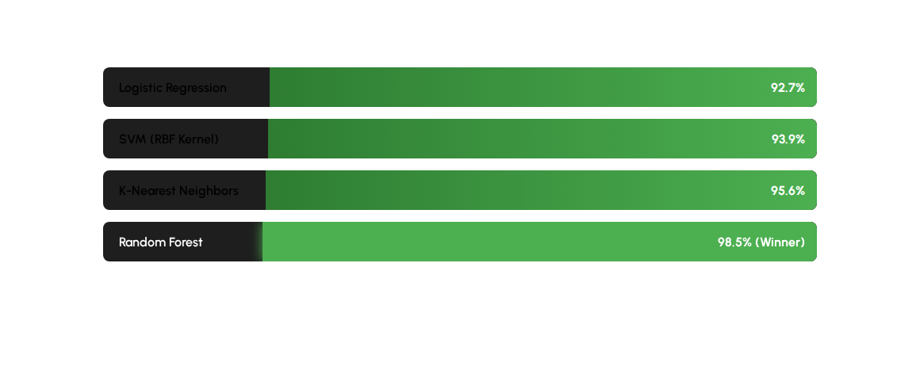
Model Performance Comparison
Random Forest was selected for its ability to handle non-linear feature interactions and resistance to overfitting.
Notes:
“We compared multiple machine learning models and selected Random Forest.
Reasons:
Handles non-linear interactions extremely well.
More robust to missing or incomplete features.
Provides high training accuracy while avoiding overfitting.
Overall, it gave the most consistent and stable performance across our tests.”

Slide 6

The Inference Gap
This is the critical engineering challenge of the project:
The Model expects 30 features (including SSL state, DNS records, Domain Age).
The User only provides a raw string: "http://evil-site.com"
How do we bridge the gap between a raw string and a complex feature vector in real-time?
Notes:
One of the biggest engineering challenges in this project is what we call the Inference Gap.
The model was trained on 30 features, many of which require: • WHOIS lookups • SSL certificate validation • DNS record checks
But the user only gives us a raw URL string like ‘http://malicious-site.com’.
Real-time WHOIS or SSL checks take around 2–3 seconds, which makes the system slow and impractical.
We needed a way to predict using minimal information while keeping the model compatible with its training structure.”

Slide 7
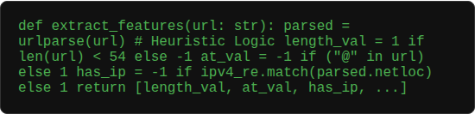
Real-Time Feature Extraction
We implemented a custom extraction engine in Python that parses the URL string using RegEx and heuristics.
>
IP Address: RegEx checks for IPv4/IPv6 patterns.
>
URL Length: >54 chars is flagged as phishing (-1).
>
@ Symbol: Presence indicates browser redirection exploit.
>
Hyphens: "Prefix_Suffix" feature detection for typosquatting.
Notes:
To solve this, we built a custom real-time feature extractor using Python, RegEx, and heuristics.
Features extracted live: • IP Address detection using RegEx • URL length (long URLs are suspicious) • Presence of '@' symbol • Hyphens, which often indicate typo-squatting • Basic prefix-suffix patterns
These lexical features are extremely powerful for on-the-spot detection.”

Slide 8

Zero-Imputation Strategy
Why this works with Random Forest?
Hybrid Vector Creation
In our dataset, 0 often represents "Suspicious" or "Missing".
Since we cannot query WHOIS databases in real-time without slowing down the user experience, we use a Zero-Imputation strategy.
Random Forest is robust enough to handle these constant values. It relies heavily on the 5 lexical features we do provide to make the decision, effectively treating the unknown features as neutral.
We extract the 5 critical lexical features we can see, and set the remaining 25 complex features (like SSL) to 0.
Notes:
Since we cannot fetch the other 25 features instantly, we use a technique called Zero-Imputation.
Process: • Create a feature vector of size 30 • Fill only the 5 live lexical features • Set the remaining 25 features to zero
Why this works: • In the dataset, ‘0’ often means Suspicious or Missing, which matches real-world inference. • Random Forest is strong enough to ignore the missing fields and rely on the provided lexical features.
This approach gives us sub-50ms inference time, making the system extremely fast

Slide 9

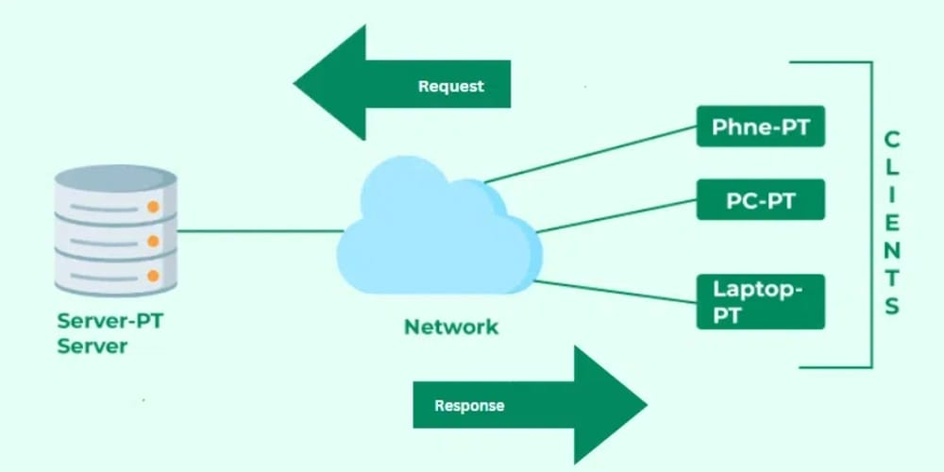
Explainability Integration
Beyond "Black Box" Predictions
Security tools must educate the user. Our system doesn't just return a label.
>
Feature Mapping: The backend returns the specific features that triggered the detection.
>
User Feedback: If a URL is blocked, the UI says "Warning: IP Address Used" or "Warning: @ Symbol Detected".
>
SHAP Values: The architecture supports SHAP (Shapley Additive Explanations) to quantify exactly how much each feature contributed to the risk score.

Slide 10



Backend Implementation
Server
Caching
Performance
Custom ThreadingHTTPServer. Handles multiple concurrent requests without blocking the main thread.
Uses joblib/pickle to serialize the trained model. Eliminates re-training time on server restart.
Inference time is sub-50ms due to local heuristic extraction avoiding external API calls.

Slide 11
Limitations & Future Roadmap
Future Roadmap
>
Deep Learning: Implement CNN/LSTM models to read URLs as character sequences, removing the need for manual feature extraction.
Current Limitations
>
Feature Gap: Relying on 0-imputation for SSL features reduces accuracy for sophisticated attacks.
>
Live API Integration: Async calls to Google Safe Browsing or SSL Labs for real-time certificate validation.
>
Lexical Only: Cannot detect phishing on compromised legitimate domains (e.g., hacked wordpress sites).
>
Browser Extension: Porting the logic to a Chrome Extension for passive protection.

Slide 12
Conclusion
We successfully engineered a full-stack Phishing Detection System.
98.5%
By combining the robustness of Random Forest with the speed of Heuristic Analysis, we created a tool that is both accurate on benchmarks and usable in real-time scenarios.
TRAINING ACCURACY
Bridging the gap between static data science and dynamic web security.

Slide 13
Thank You

